Slide 1
Big Mountain Ski Resort
Ticket Price Optimization
Agne Adukaite Aklifazla
Springboard 2022

Slide 2
Recommendation and key findings
Ticket pricing. Evaluate current ticket price, look for the possibilities to increase it.
Operating costs. Evaluating operating costs, are they justifiable, are all resort’s facilities being used to their full capacity fully by visitors (Additional chair installed with operating costs increase of $1,540,000 this season).
Resort’s features. Compare Big Mountain Ski Resort features to other ski resorts in the area and throughout United States.

Slide 3
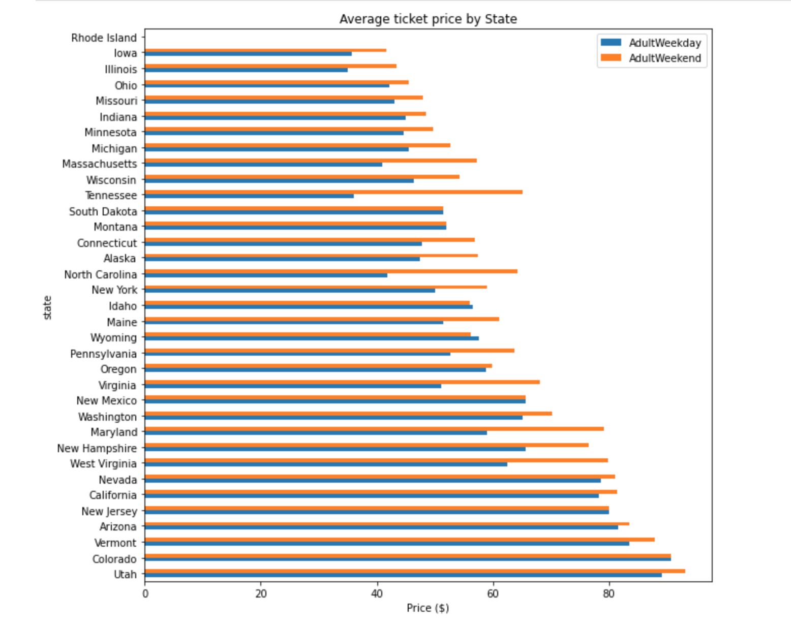
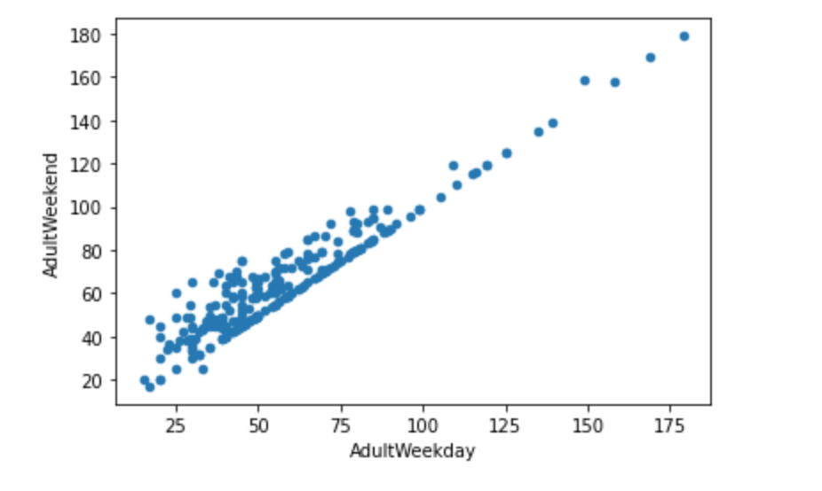
Modeling Results and Analysis

Slide 4
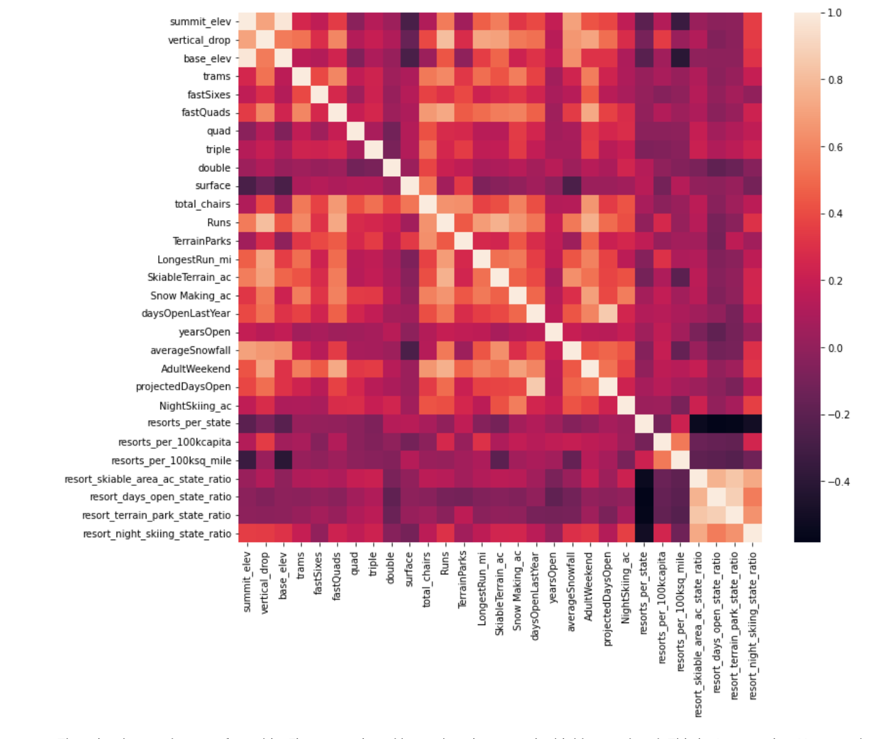
Modeling Results and Analysis
Features impacting the ticket price:
Vertical drop
Fast Quads
Runs
Snow Making
Same results are found in the further analysis using Best Random Forest Regressor Feature importance.

Slide 5
Modeling Results and Analysis
Without taken in consideration ski resorts’ features mean ticket price value - $63.00.
Machine learning model is applied with a test/train data split. Values are crossed checked for the accuracy of calculations.
Four scenarios are created:
Close up to 10 of the least used runs. The number of runs is the only parameter varying.
Big Mountain is adding a run, increasing the vertical drop by 150 feet, and installing an additional chair lift.
Repeating the previous one but adding 2 acres of snow making.
This scenario calls for increasing the longest run by .2 miles and guaranteeing its snow coverage by adding 4 acres of snow making capability.

Slide 6
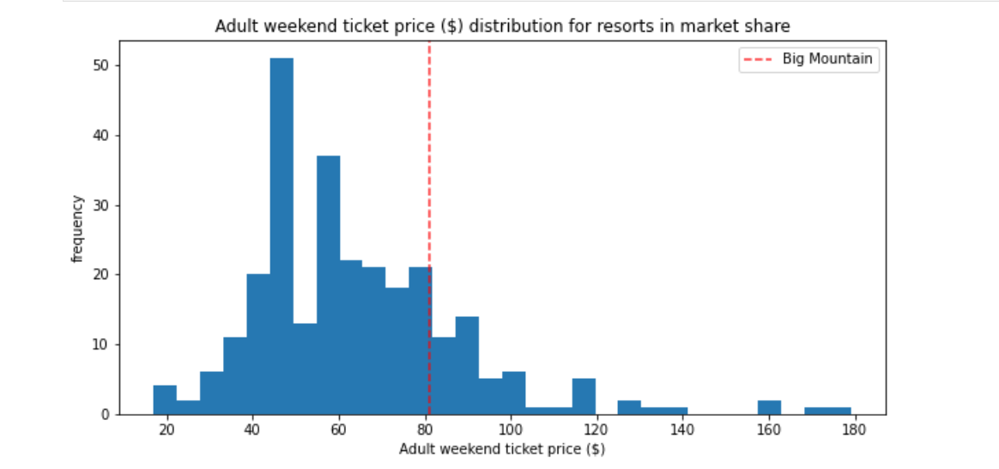
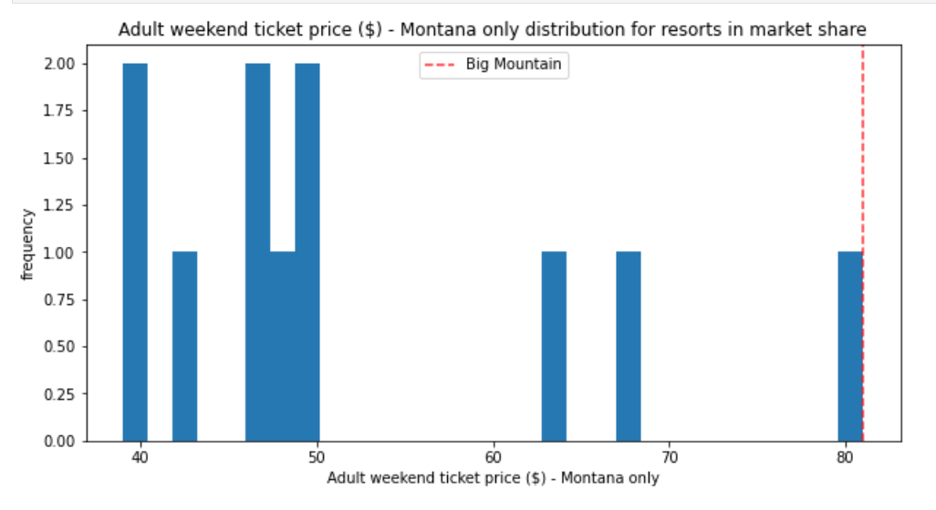
Modeling and Analysis
Ticket pricing in US and Montana

Slide 7
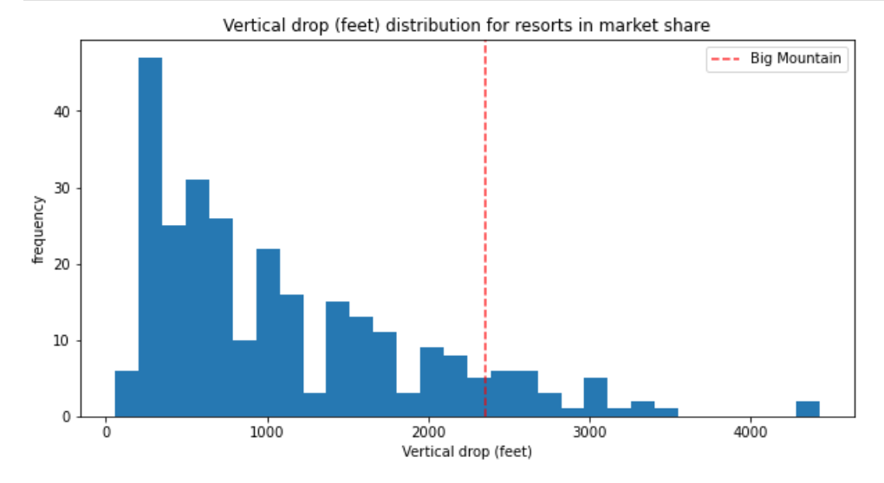
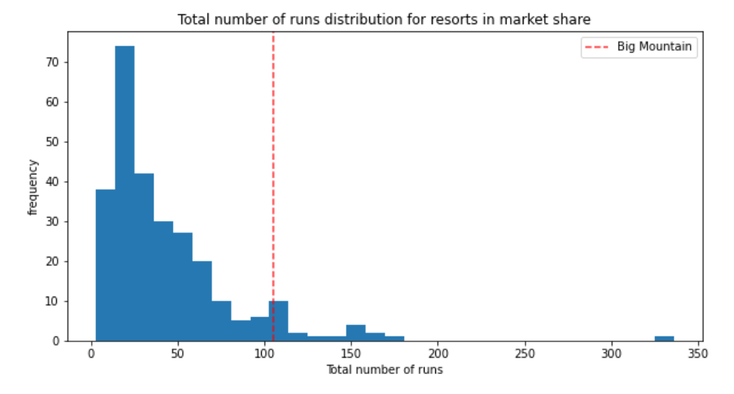
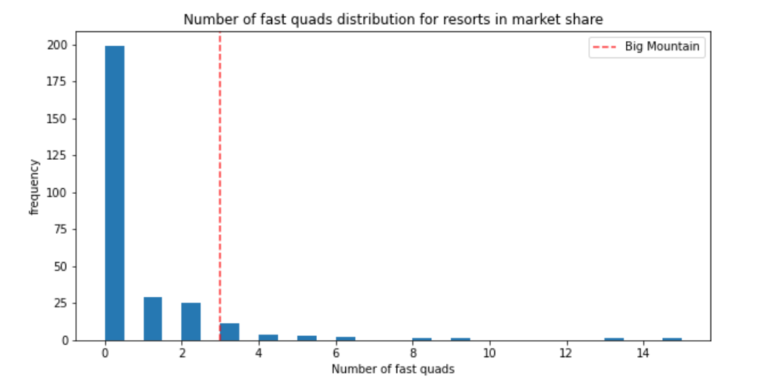
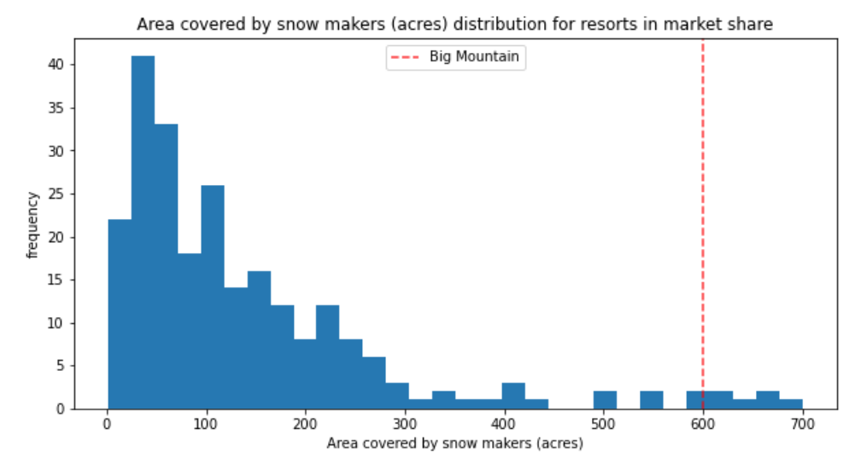
Modeling and Analysis

Slide 8
First Scenario | Second Scenario | Third Scenario | Fourth Scenario
The model says closing one run makes no difference. Closing 2 and 3 successively reduces support for ticket price and so revenue. If Big Mountain closes down 3 runs, it seems they may as well close down 4 or 5 as there's no further loss in ticket price. Increasing the closures down to 6 or more leads to a large drop. | This scenario increases support for ticket price by $8.61 Over the season, this could be expected to amount to $15065471 | This scenario increases support for ticket price by $9.90 Over the season, this could be expected to amount to $17322717 Such a small increase in the snow making area makes no difference! | Although the longest run feature was used in the linear model, the random forest model (the one we chose because of its better performance) only has longest run way down in the feature importance list.

Slide 9
Summary and conclusion
The optimal scenario is number 2.
With one additional chair, Big Mountain Ski Resort would rise even more in vertical drop and chairs features than the other resorts. Additional chair cost is $1,540,000, but this improvement would bring $15,065,471 revenue during the season.
Additional data which would be useful in further analysis of the ticket price determination could be:
seasonal pass prices
equipment supply and rental prices Big Mountain Ski Resort costs data:
snowmaking costs, how it changes during the season
additional chair operating cost (is it the same cost as the chair installed recently? more/less?
the cost of increasing vertical drop Although the Big Mountain Ski resort ticket price is one of the highest in the state of Montana, the state should not be the factor determining the ticket price. As our previous analysis showed, the state, does not have a significant effect on pricing the tickets. The most significant features discussed in the notebook, and the Big Mountain Ski Resort is ranked high in nearly all of them. Wen using Random Forest Model and providing additional information, it is possible to calculate ticket price more accurately with strong evidence of success.

